Slide 1
Process Models
Perspective Models: The Waterfall
Incremental Models: Increment and RAD
Evolutionary Model: Prototype and Spiral
Specialized Process Models: Component, Formal Methods, AOSD
Unified Process Model

Slide 2
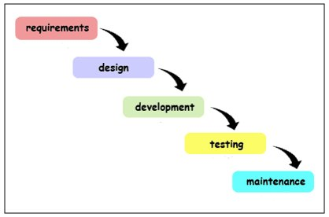
Software Development Life Cycle (SDLC) Phases

Slide 3
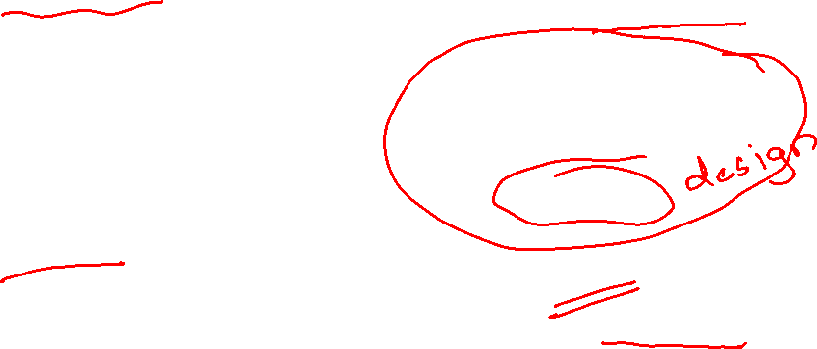
Process Flow

Slide 4
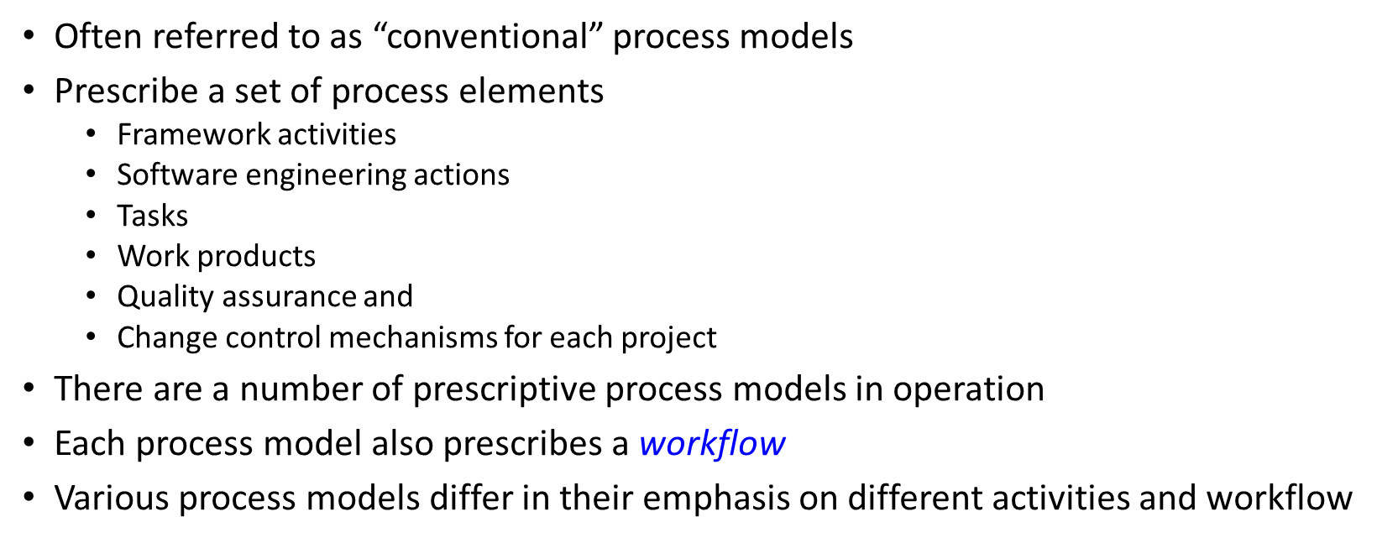
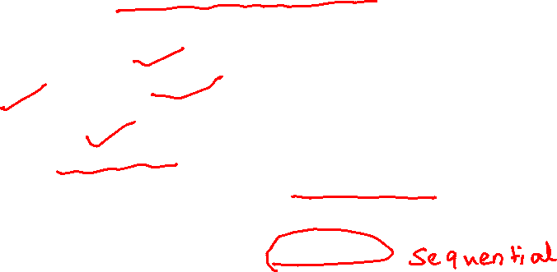
Prescriptive Process Models

Slide 5

The Waterfall Model
Sometimes called the classic life cycle
Suggests a systematic, sequential (or linear) approach to s/w development
The oldest paradigm for s/w engineering
Works best when –
Requirements of a problem are reasonably well understood
Well-defined adaptations or enhancements to an existing system must be made
Requirements are well-defined and reasonably stable
Technology is understood
There are no ambiguous requirements
Ample resources with required expertise are available freely
The project is short

Slide 6
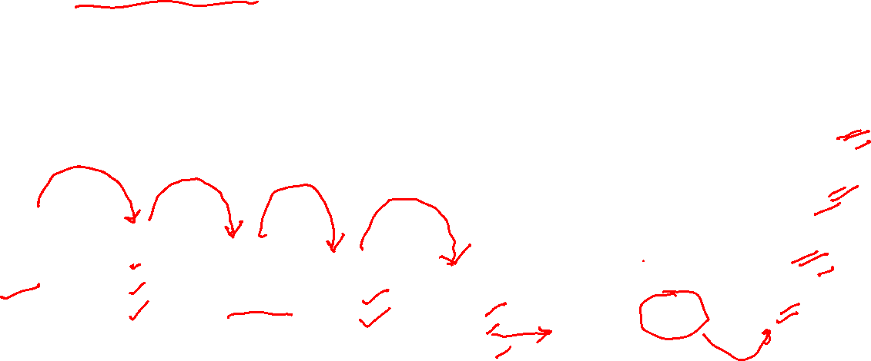
The Waterfall Model
Variations in the Waterfall Model
Basic Model

Slide 7

The Waterfall Model - Problems
Real projects rarely follow the sequential flow
Accommodates iteration indirectly
Changes can cause confusion
It is often difficult for the customer to state all requirements explicitly
Has difficulty accommodating the natural uncertainty that exists at the beginning of many projects
The customer must have patience
A working version of the program(s) will not be available until late in the project time-span
A major blunder, if undetected until the working program is reviewed, can be disastrous
Leads to “blocking states” for team members

Slide 8
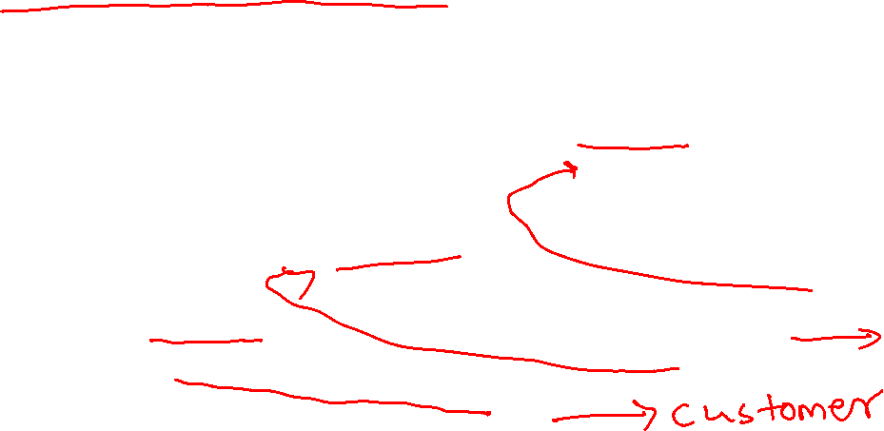
Incremental Process Models

Slide 9

Incremental Process Models
Combines elements of the waterfall model applied in an iterative fashion
Each linear sequence produces deliverable “increments” of the software
The first increment is often a core product
The core product is used by the customer (or undergoes detailed evaluation)
Based on evaluation results, a plan is developed for the next increment

Slide 10
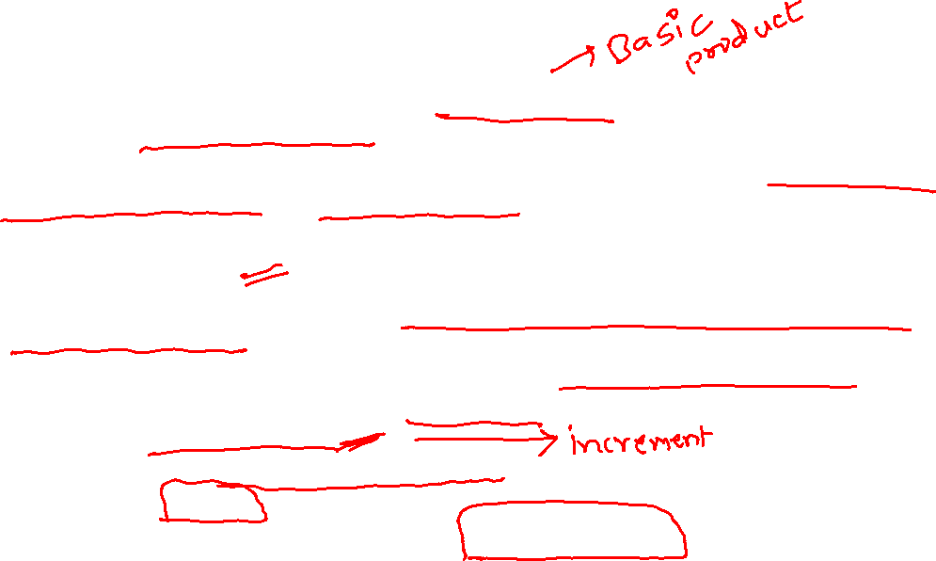
Incremental Process Models
The incremental process model, like prototyping and other evolutionary approaches, is iterative in nature
But unlike prototyping, the incremental model focuses on the delivery of an operational product with each increment
Particularly useful when
Staffing is unavailable
This model can be used when the requirements of the complete system are clearly defined and understood.
Major requirements must be defined; however, some details can evolve with time.
There is a need to get a product to the market early.
A new technology is being used
Resources with needed skill set are not available
There are some high-risk features and goals.
Increments can be planned to manage technical risks

Slide 11
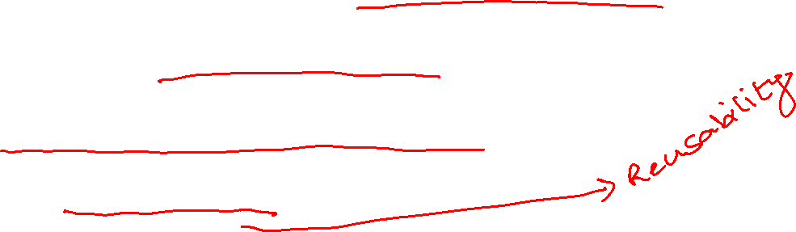
The RAD Model
Rapid Application Development is Incremental Process Model
Emphasizes on short development cycle
A “high speed” adaptation of the waterfall model
Uses a component-based construction approach
May deliver software within a very short time period (e.g. , 60 to 90 days) if requirements are well understood and project scope is constrained

Slide 12
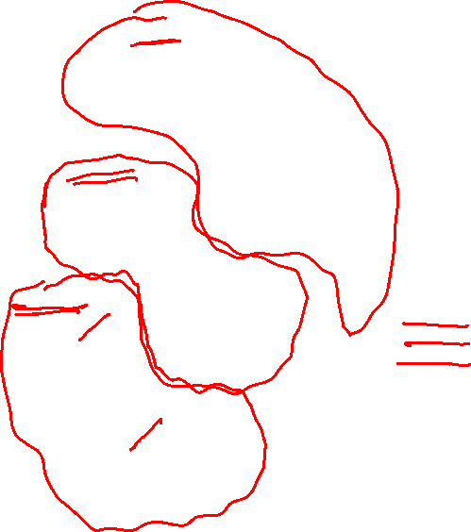
The RAD Model
Team # n
Modeling
business modeling
data modeling
process modeling
Construction
component reuse
automatic code
generation
testing
Team # 2
Modeling
business modeling
data modeling
process modeling
Communication
Planning
Construction
component reuse
automatic code
generation
testing
Deployment
integration
delivery
feedback
Team # 1
Modeling
business modeling
data modeling
process modeling
Construction
component reuse
automatic code
generation
testing
60 – 90 days

Slide 13

The RAD Model
The time constraints imposed on a RAD project demand “scalable scope”
The application should be modularized and addressed by separate RAD teams
Integration is required
Particularly useful when:
RAD should be used when there is a need to create a system that can be modularized in 2-3 months of time.
It should be used if there’s high availability of designers for modeling and the budget is high enough to afford their cost along with the cost of automated code generating tools.
RAD SDLC model should be chosen only if resources with high business knowledge are available and there is a need to produce the system in a short span of time (2-3 months).

Slide 14

The RAD Model - Drawbacks
For large, but scalable projects, RAD requires sufficient human resources
RAD projects will fail if developers and customers are not committed to the rapid-fire activities
If a system cannot be properly modularized, building the components necessary for RAD will be problematic
If high performance is an issue, and performance is to be achieved through tuning the interfaces to system components, the RAD approach may not work
RAD may not be appropriate when technical risks are high

Slide 15
Evolutionary Process Models
Software, like all complex systems, evolves over a period of time
Business and product requirements often change as development proceeds, making a straight-line path to an end product is unrealistic
Evolutionary models are iterative

Slide 16

Prototyping
Customer defines general objectives but not sure with detailed input, processing and output.
This model assists the software engineer and the customer to better understand what to be built when requirements are fuzzy.

Slide 17

Prototyping
Communication
Quick plan
Q
u
i
c
k
p
l
a
n
u
i
t
o
Modeling
Quick design
Deployment
Delivery
& Feedback
o
y
t
D
e
i
v
y
Construction
of
prototype
e
a
c
C
o
s
t
r
c
i
n
f
r
t
t
p
e

Slide 18
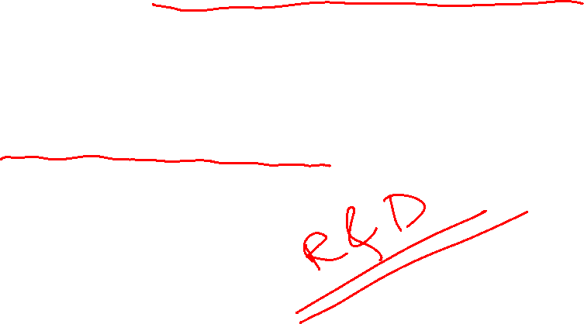
Prototyping - Problems
Customers may press for immediate delivery of working but inefficient products
The developer often makes implementation compromises in order to get a prototype working quickly

Slide 19

The Spiral Model
Couples the iterative nature of prototyping with the controlled and systematic aspects of the waterfall model
It provides the potential for rapid development of increasingly more complete versions of the software
It is a risk-driven process model generator
It has two main distinguishing features
Cyclic approach
Incrementally growing a system’s degree of definition and implementation while decreasing its degree of risk
A set of anchor point milestones
For ensuring stakeholder commitment to feasible and mutually satisfactory system solution

Slide 20
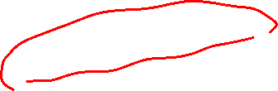
The Spiral Model
Planning
estimation
scheduling
risk analysis
Communication
Modeling
analysis
design
Start
Deployment
Construction
delivery
code
feedback
test

Slide 21

The Spiral Model
Unlike other process models that end when software is delivered, the spiral model can be adapted to apply throughout the life of the computer s/w
The circuits around the spiral might represent
Concept development project
New Product development project
Product enhancement project
The spiral model demands a direct consideration of technical risks at all stages of the project

Slide 22
Particularly useful when
When costs and risk evaluation is important
For medium to high-risk projects
Long-term project commitment unwise because of potential changes to economic priorities
Users are unsure of their needs
Requirements are complex
New product line
Significant changes are expected (research and exploration)

Slide 23
The Spiral Model - Drawbacks
It may be difficult to convince customers (particularly in contract situations) that the evolutionary approach is controllable.
It demands considerable risk assessment expertise and relies on this expertise for success.
If a major risk is not uncovered and managed, problems will undoubtedly occur.

Slide 24
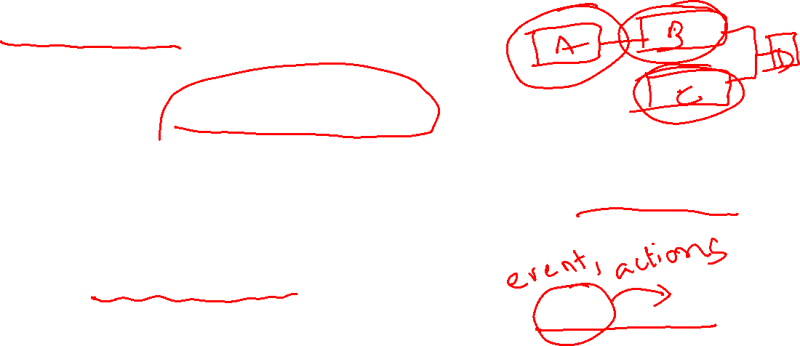
The Concurrent Development Model
Sometimes called concurrent engineering
Can be represented schematically as a series of framework activities, s/w engineering actions and tasks, and their associated states
Defines a series of events that will trigger transitions from state to state for each of the s/w engineering activities, actions, or tasks
Applicable to all types of s/w development
Defines a network of activities
Events generated at one point in the process network trigger transitions among the states

Slide 25
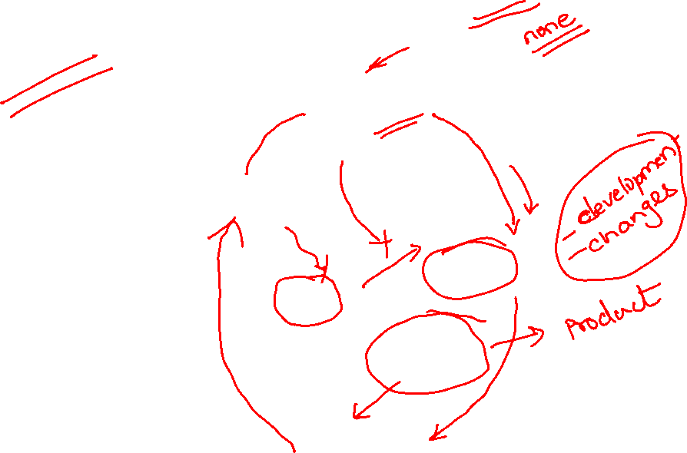
The Concurrent Development Model

Slide 26
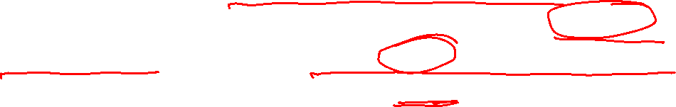
Weaknesses of Evolutionary Process Models
Uncertainty in the number of total cycles required
Most project management and estimation techniques are based on linear layouts of activities
Do not establish the maximum speed of the evolution
Software processes should be focused on flexibility and extensibility rather than on high quality, which sounds scary
However, we should prioritize the speed of the development over zero defects. Why?

Slide 27

Specialized Process Models
Take on many of the characteristics of one or more of the conventional models
Tend to be applied when a narrowly defined software engineering approach is chosen
Examples:
Component-Based Development
The Formal Methods Model
Aspect-Oriented Software Development

Slide 28
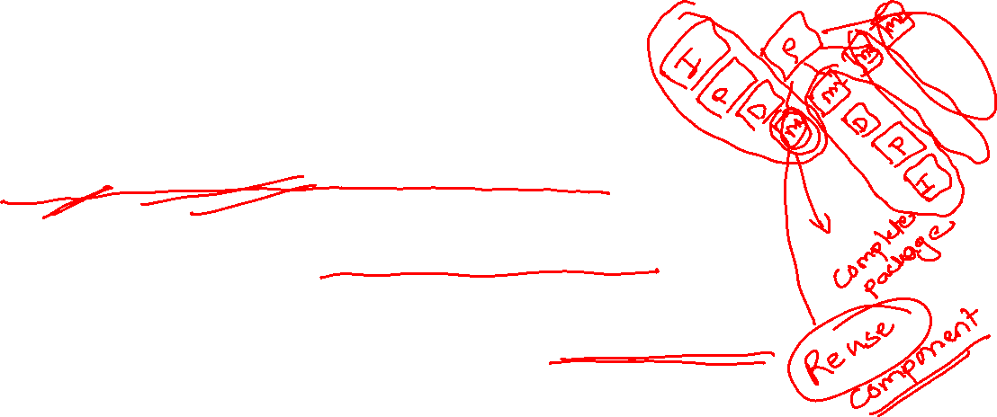
Component-Based Development
Commercial off-the-shelf (COTS) software components can be used
Components should have well-defined interfaces
Incorporates many of the characteristics of the spiral model
Evolutionary in nature

Slide 29
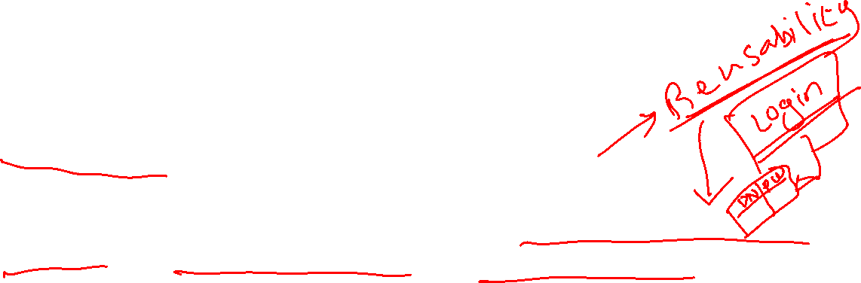
Component-Based Development
Candidate components should be identified first
Components can be designed as either conventional software modules or object-oriented classes or packages of classes

Slide 30

The Formal Methods Model
Encompasses a set of activities that leads to formal mathematical specification of computer software
Have provision to apply a rigorous, mathematical notation
Ambiguity, incompleteness, and inconsistency can be discovered and corrected more easily – not through ad hoc review, but through the application of mathematical analysis
Offers the promise of defect-free software

Slide 31

The Formal Methods Model – Critical Issues
The development of formal models is currently quite time-consuming and expensive
Extensive training is required
It is difficult to use the models as a communication mechanism for technically unsophisticated customers

Slide 32
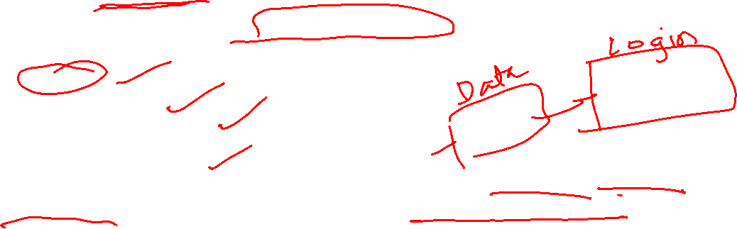
Aspect-Oriented Software Development (AOSD)
Certain “concerns” – customer required properties or areas of technical interest – span the entire s/w architecture
Example “concerns”
Security
Fault Tolerance
Task synchronization
Memory Management
When concerns cut across multiple system functions, features, and information, they are often referred to as crosscutting concerns

Slide 33

Aspect-Oriented Software Development (AOSD)
Aspectual requirements define those crosscutting concerns that have impact across the s/w architecture
AOSD or AOP (Aspect-Oriented Programming) provides a process and methodological approach for defining, specifying, designing, and constructing aspects – “mechanisms beyond subroutines and inheritance for localizing the expression of a crosscutting concern”
A distinct aspect-oriented process has not yet matured
It is likely that AOSD will adopt characteristics of both the spiral and concurrent process models

Slide 34
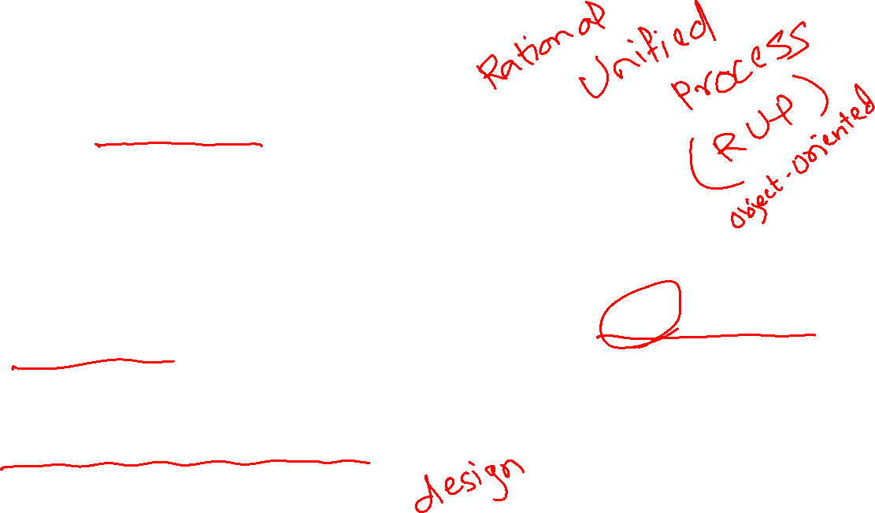
The Unified Process (UP)
It is a use-case driven, architecture-centric, iterative and incremental software process
UP is an attempt to draw on the best features and characteristics of conventional s/w process models
Also implements many of the best principles of agile software development
UP is a framework for object-oriented software engineering using UML (Unified Modeling Language)

Slide 35
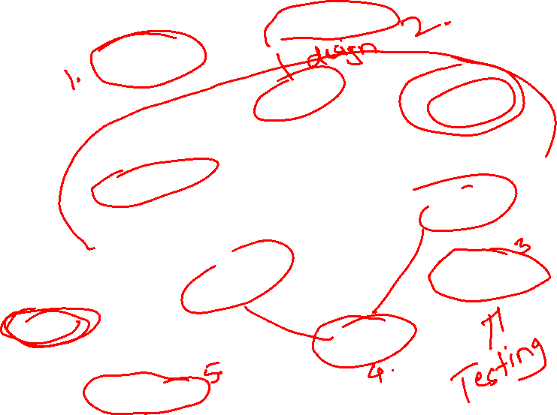
Phases of the Unified Process
Elaboration
Inception
planning
modeling
communication
construction
deployment
Construction
Release
Transition
software increment
Production

Slide 36
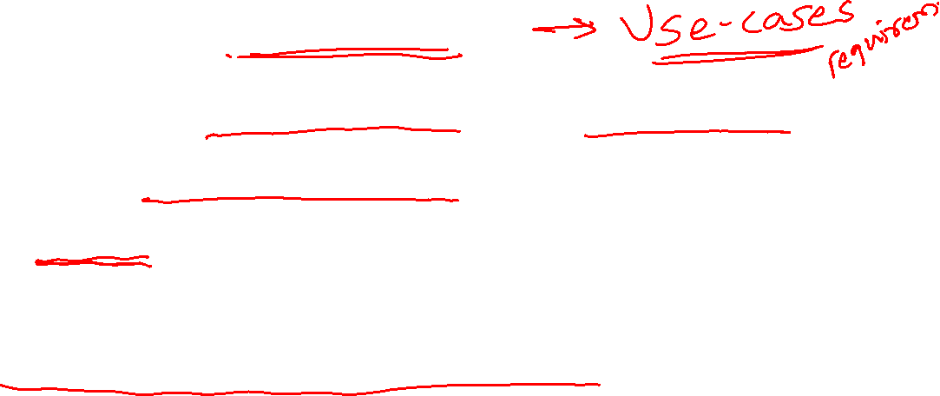
Phases of UP - Inception
Encompasses both customer communication and planning activities
Fundamental business requirements are described through a set of preliminary use-cases
A use-case describes a sequence of actions that are performed by an actor (e.g., a person, a machine, another system) as the actor interacts with the software
A rough architecture for the system is also proposed

Slide 37
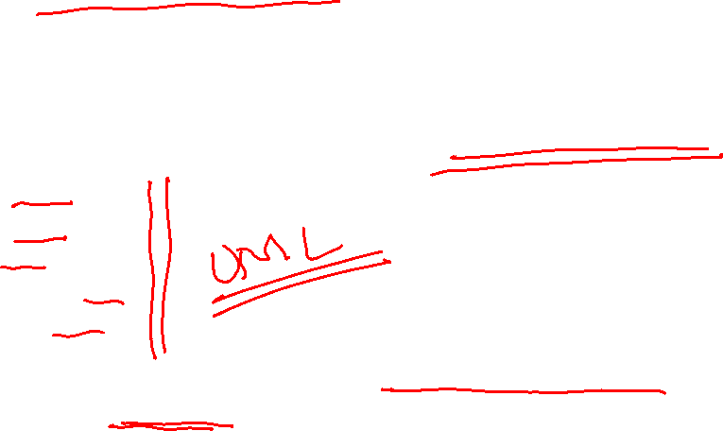
Phases of UP - Elaboration
Encompasses customer communication and modeling activities
Refines and expands the preliminary use-cases
Expands the architectural representation to include five different views of the software
The use-case model
The analysis model
The design model
The implementation model
The deployment model
In some cases, elaboration creates an “executable architectural baseline” that represents a “first cut” executable system

Slide 38
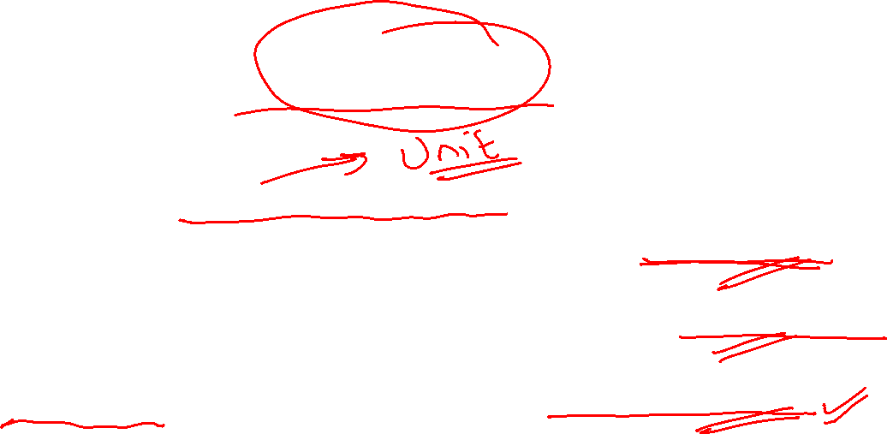
Phases of UP - Construction
Makes each use-case operational for end-users
As components are being implemented, unit tests are designed and executed for each
Integration activities (component assembly and integration testing) are conducted
Use-cases are used to derive a suite of acceptance tests

Slide 39

Phases of UP - Transition
Software is given to end-users for beta testing
The software team creates the necessary support information –
User manuals
Trouble-shooting guides
Installation procedures
At the conclusion of the transition phase, the software increment becomes a usable software release

Slide 40

Phases of UP - Production
Coincides with the deployment activity of the generic process
The on-going use of the software is monitored
Support for the operating environment (infrastructure) is provided
Defect reports and requests for changes are submitted and evaluated

Slide 41
Unified Process Work Products
Inception
Vision document
Initial use-case model
Elaboration
Analysis model, design model
Construction
Implementation model, deployment model, test model
Transition
Delivered software, beta test reports, general user feedback

Slide 42
Distribution of effort…
How programmers spend their time
Typing programs 13%
Searching and Reading programs 16%
Job communication 32%
Others 39%
Programmers spend more time in reading programs than in writing them.
Writing programs is a small part of their lives.

Slide 43

Defects
Distribution of error occurrences by phase is
Req. - 20%
Design - 30%
Coding - 50%
Defects can be injected at any of the major phases.
Cost of latency: Cost of defect removal increases exponentially with latency time.

Slide 44

Defects…
Cost to fix
Error ( log scale)
Time
Cheapest way to detect and remove defects close to where it is injected.
Hence must check for defects after every phase.

Slide 45

Factors to be considered for Software Development
User Satisfaction
Time
Quality factors
Adaptable for changes
Risk Management
Evolution

